Slide 1

Rental Market Analysis
Insights from Square Yards Data - Pune & Mumbai
Presented By: Jayesh Patil

Slide 2


Table of Contents
1 Business Objectives
5 Micro-Market Analysis
2 Dataset Overview
6 City-Specific Highlights
3 Market Distribution
7 Conclusion
4 Property Trends

Slide 3






Business Objectives
To analyze rental market dynamics in Pune and Mumbai, providing actionable data for investment decisions and competitive benchmarking.
Market Segmentation
Pricing Strategy
Differentiate market positioning between Mumbai (Premium) and Pune (Value) to target the correct tenant demographics.
Establish rental benchmarks per square foot to identify undervalued properties and maximize rental yield.
Demand Forecasting
Location Intelligence
Identify preferred configurations (BHK) to guide future inventory acquisition and development focus.
Pinpoint high-supply micro-markets (e.g., IT hubs like Hinjewadi) to focus marketing and acquisition efforts.

Slide 4

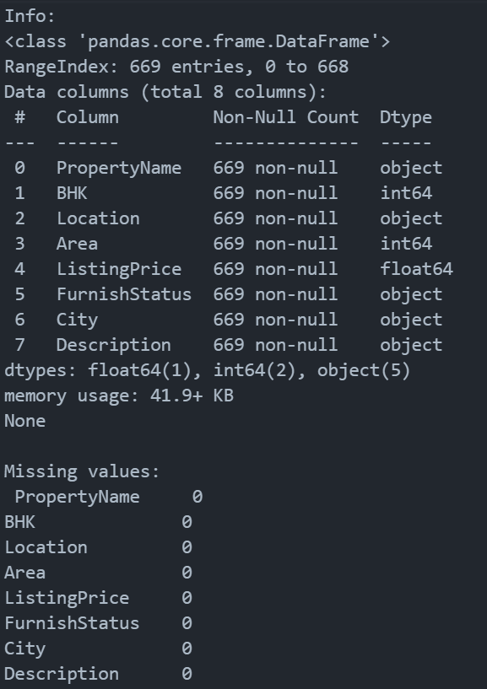
Dataset Overview
A comprehensive analysis of the rental real estate landscape in two of India's major metropolitan hubs.
Total Listings: 669 Properties
Key Markets: Pune & Mumbai
Focus Areas: Price, Location, Configuration

Slide 5
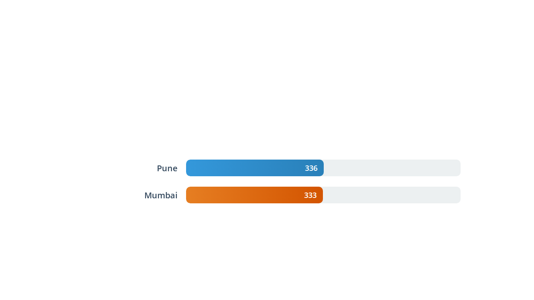
Listing Volume by City
The dataset shows an almost equal distribution of rental listings between the two cities, indicating a balanced sample size for comparative analysis.

Slide 6
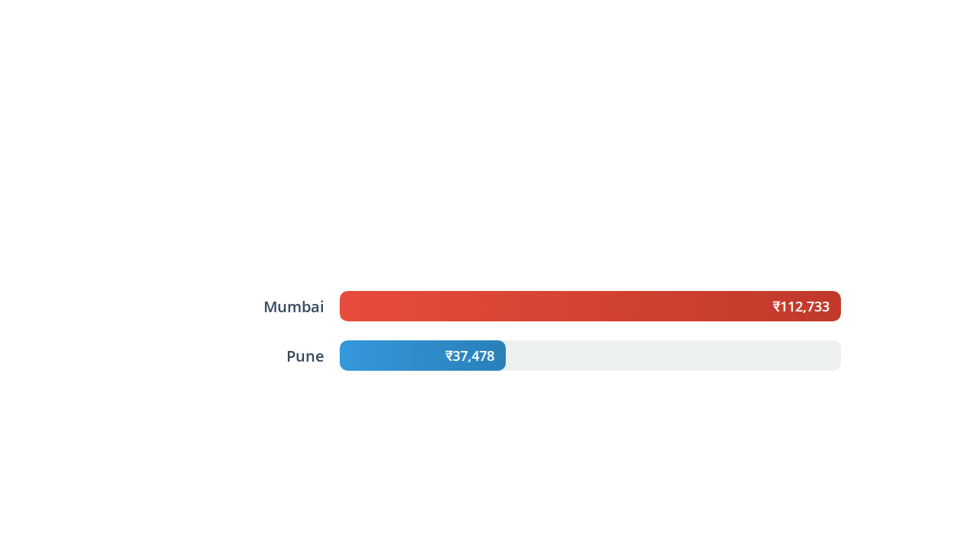

Average Rental Price
A stark contrast in rental costs is evident. Mumbai's average rental price is approximately 3x higher than Pune's, reflecting its status as a premium real estate market.

Slide 7
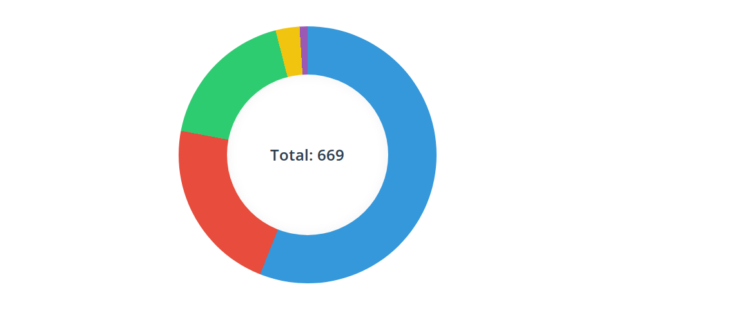

Configuration Trends (BHK)
2 BHK apartments dominate the rental market, accounting for over half of all listings, followed by 3 BHK and 1 BHK units.
2 BHK (56%)
3 BHK (22%)
1 BHK (18%)
4 BHK (3%)
5 BHK (<1%)

Slide 8
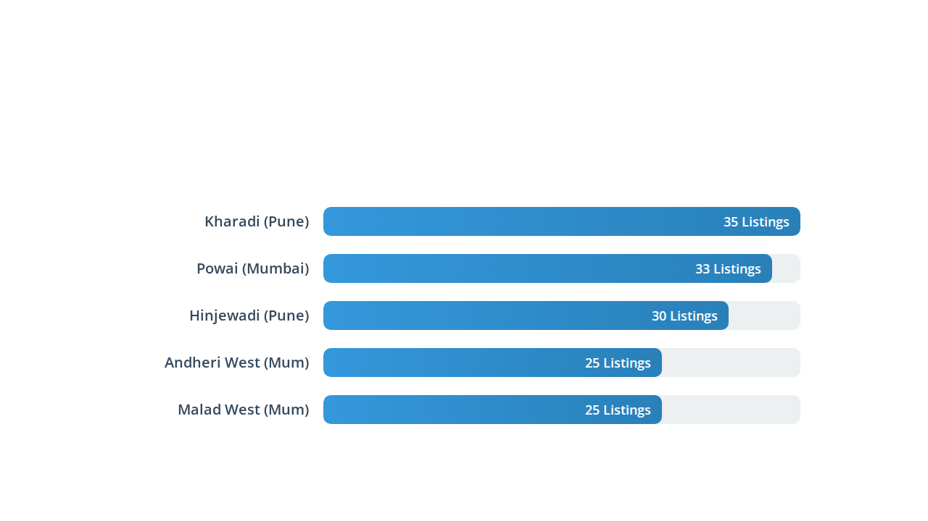

Top 5 Micro-Markets (Supply)
Kharadi and Powai emerge as the leading hubs for rental inventory, indicating high activity and tenant demand in these specific localities.

Slide 9
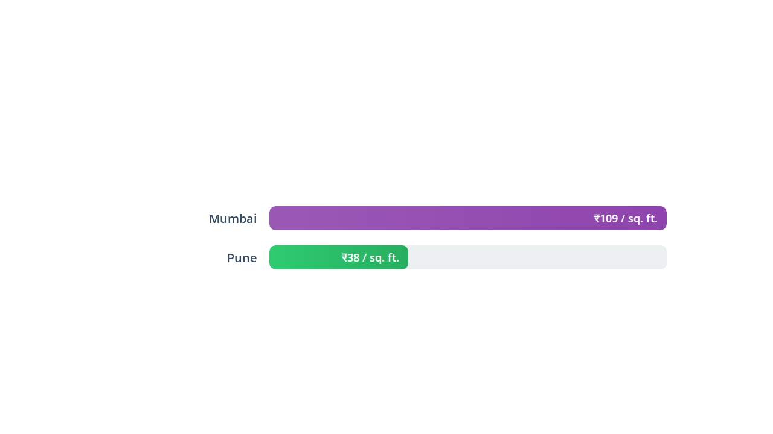
Price Efficiency (Cost per Sq. Ft.)
Analyzing the price per square foot provides a standardized comparison. Mumbai remains significantly more expensive, demanding a premium for space.
Insight:
3x more space

Slide 10

Most Expensive Locations
Based on Price per Square Foot, these micro-markets command the highest premiums in the dataset.
Rank | Location | City | Price / Sq. Ft. (Avg)
1 | Prabhat Road | Pune | ₹555
2 | Khar West | Mumbai | ₹240
3 | Mahalaxmi | Mumbai | ₹223
4 | Vasant Vihar | Mumbai | ₹222
5 | Colaba | Mumbai | ₹211

Slide 11
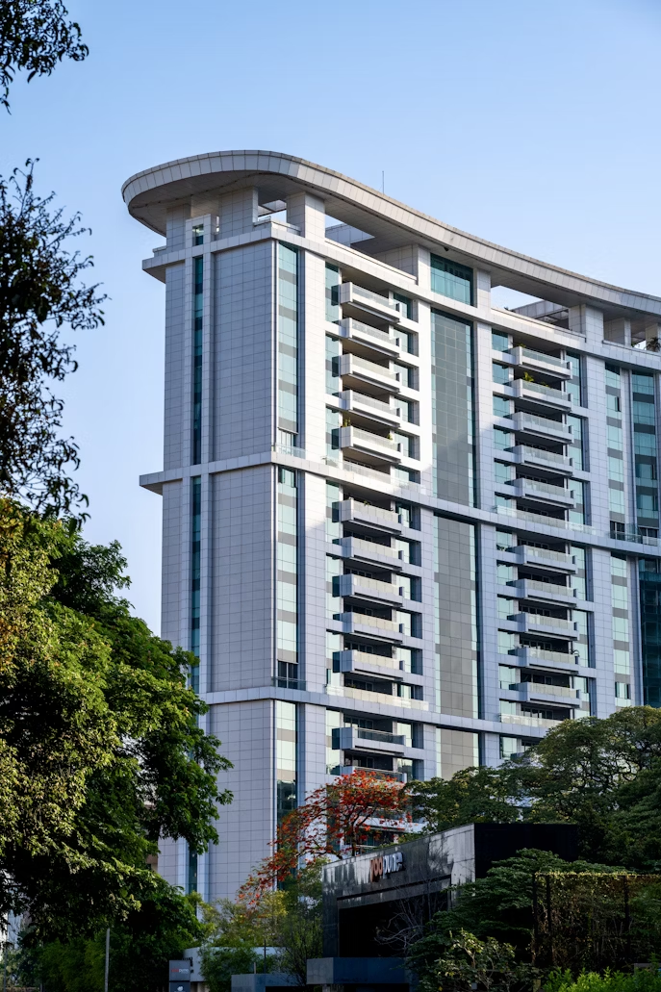

Pune Market Highlights
Key Micro-Markets
Kharadi & Hinjewadi: Driven by IT hubs, these areas show the highest listing volume, catering to working professionals.
Market Character
Affordable & Spacious: With an average rent of ₹37k and ₹38/sq.ft., Pune offers high value for money and larger living spaces.
Top Pick
Hadapsar: Emerging as a strong secondary hub with significant inventory.

Slide 12
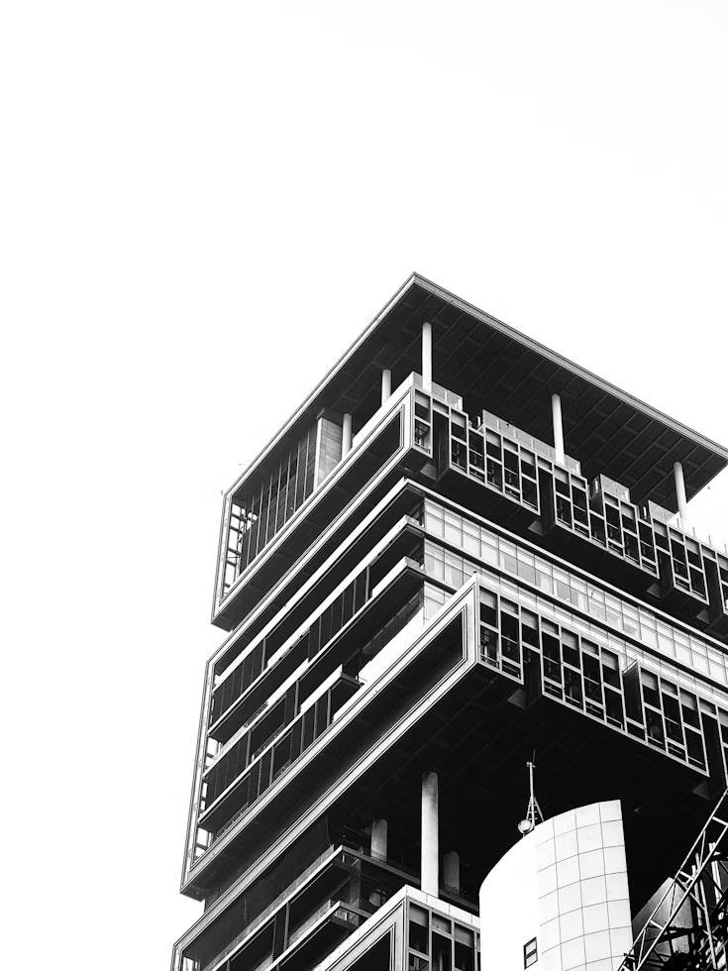
Mumbai Market Highlights
Key Micro-Markets
Powai & Andheri West: These established premium localities dominate the supply, offering lifestyle and connectivity.
Market Character
Premium Pricing: Average rents soar above ₹1.1 Lakhs. High density and demand drive the price per sq. ft. to ~₹109.
Top Pick
Malad West: A robust mid-to-premium segment market with healthy inventory levels.

Slide 13

Conclusion
Divergent Markets: Mumbai and Pune cater to distinct segments—Premium vs. Value—despite similar listing volumes.
2 BHK is King: The 2 BHK configuration is the undisputed market favorite, balancing space and affordability.
Location Matters: IT corridors (Hinjewadi, Kharadi, Powai) are the primary drivers of rental supply in both cities.

